Slide 1


Shooting Through the Sun
Amalia Gjerloev

Slide 2
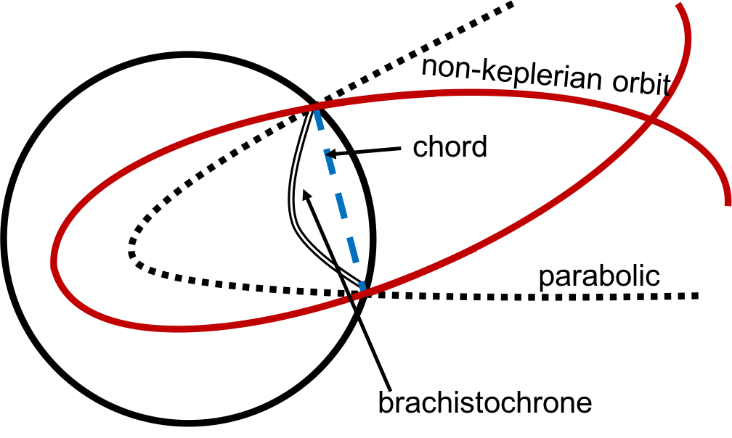
The Problem
If a satellite were to travel through the Sun, which path should it take?
Possible Solutions
Brachistochrone curves
Non-keplerian orbital paths
Notes:
Add picture of all 4 different paths with labels.

Slide 3
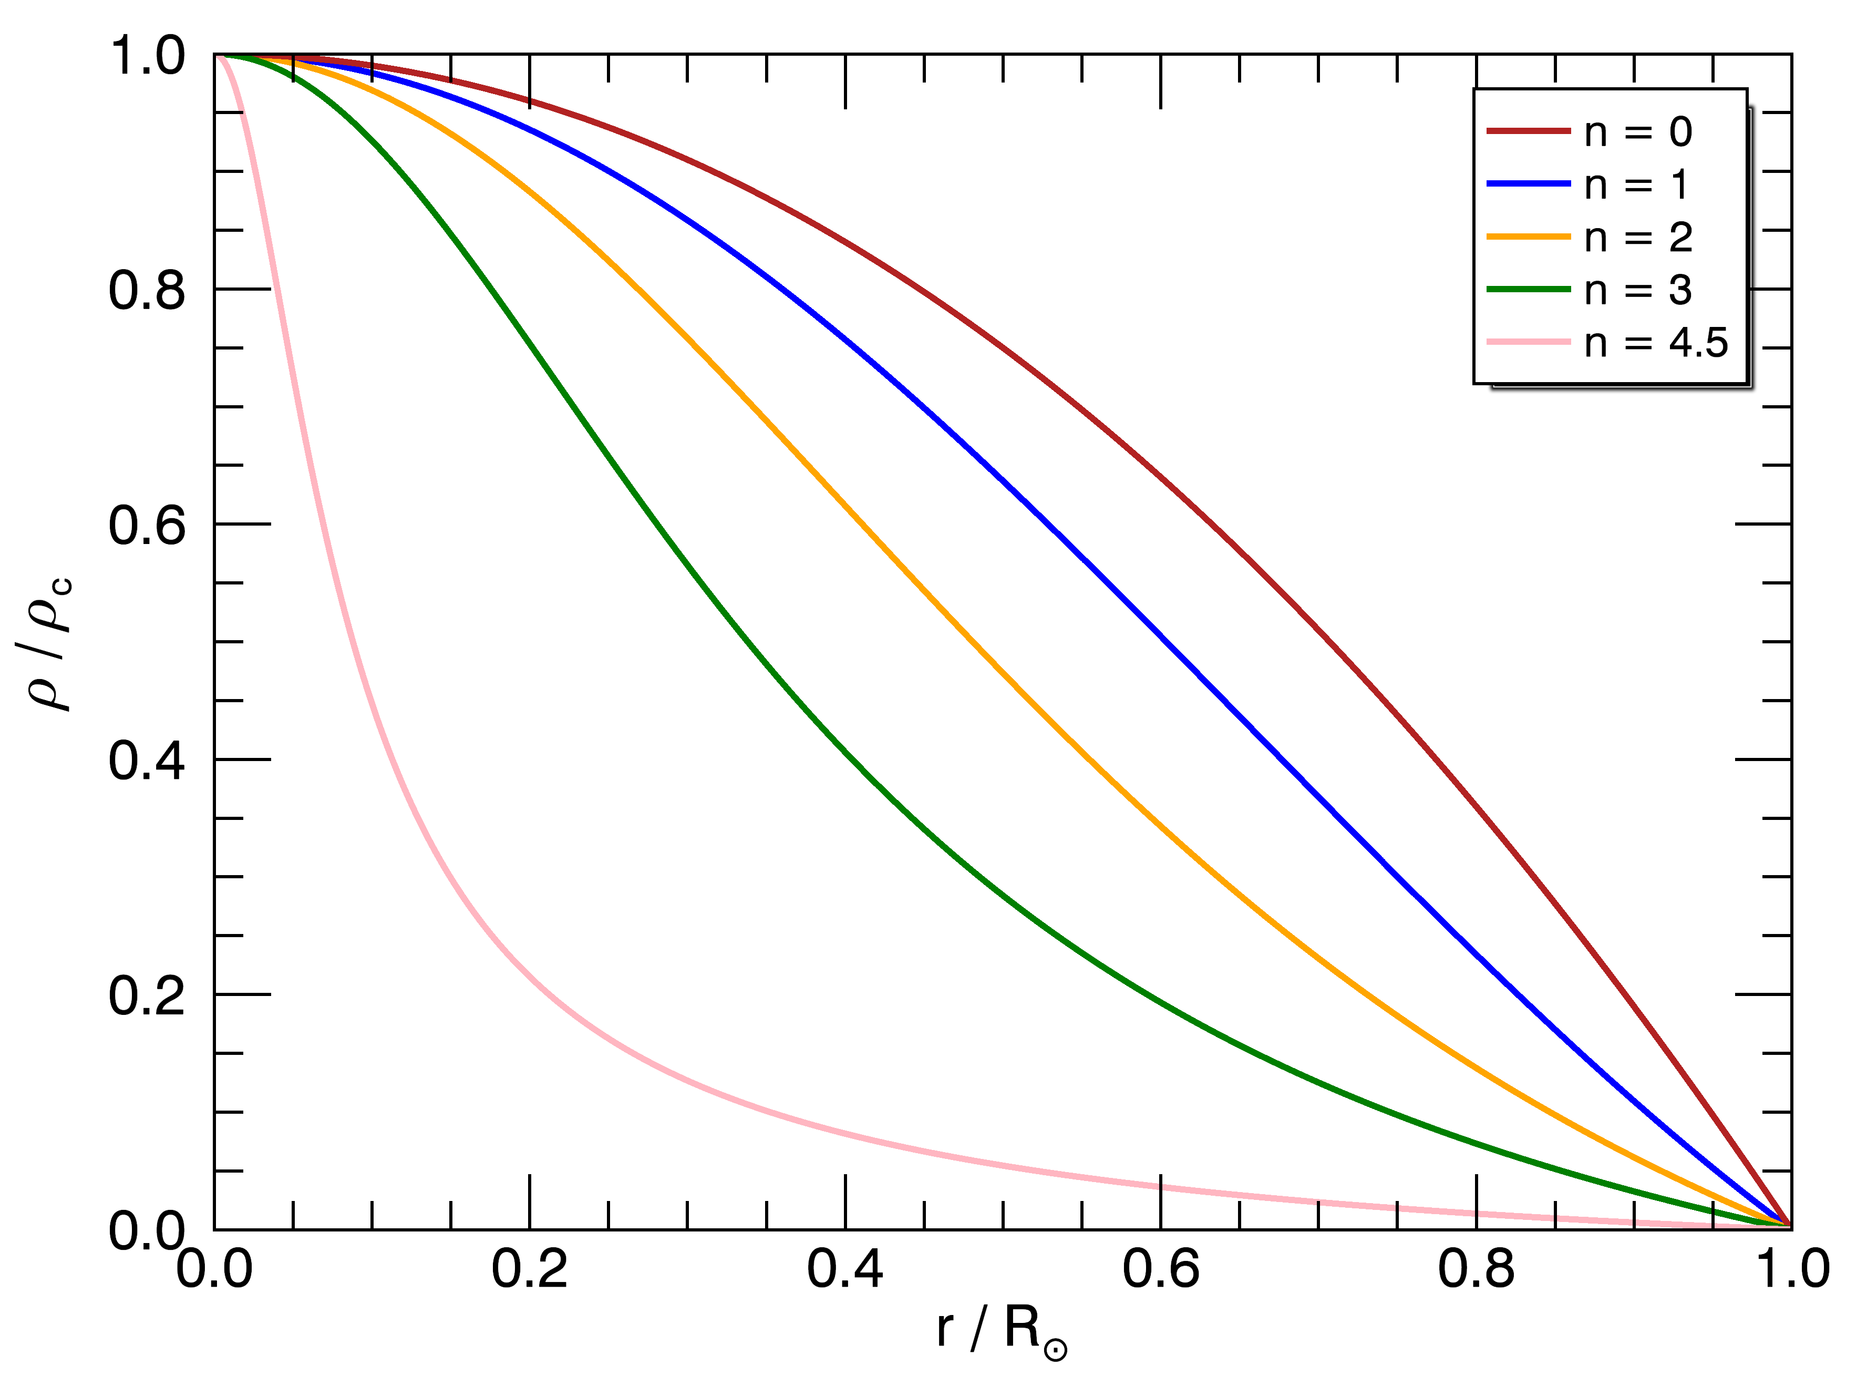
Polytropes
Notes:
Fix colours.

Slide 4
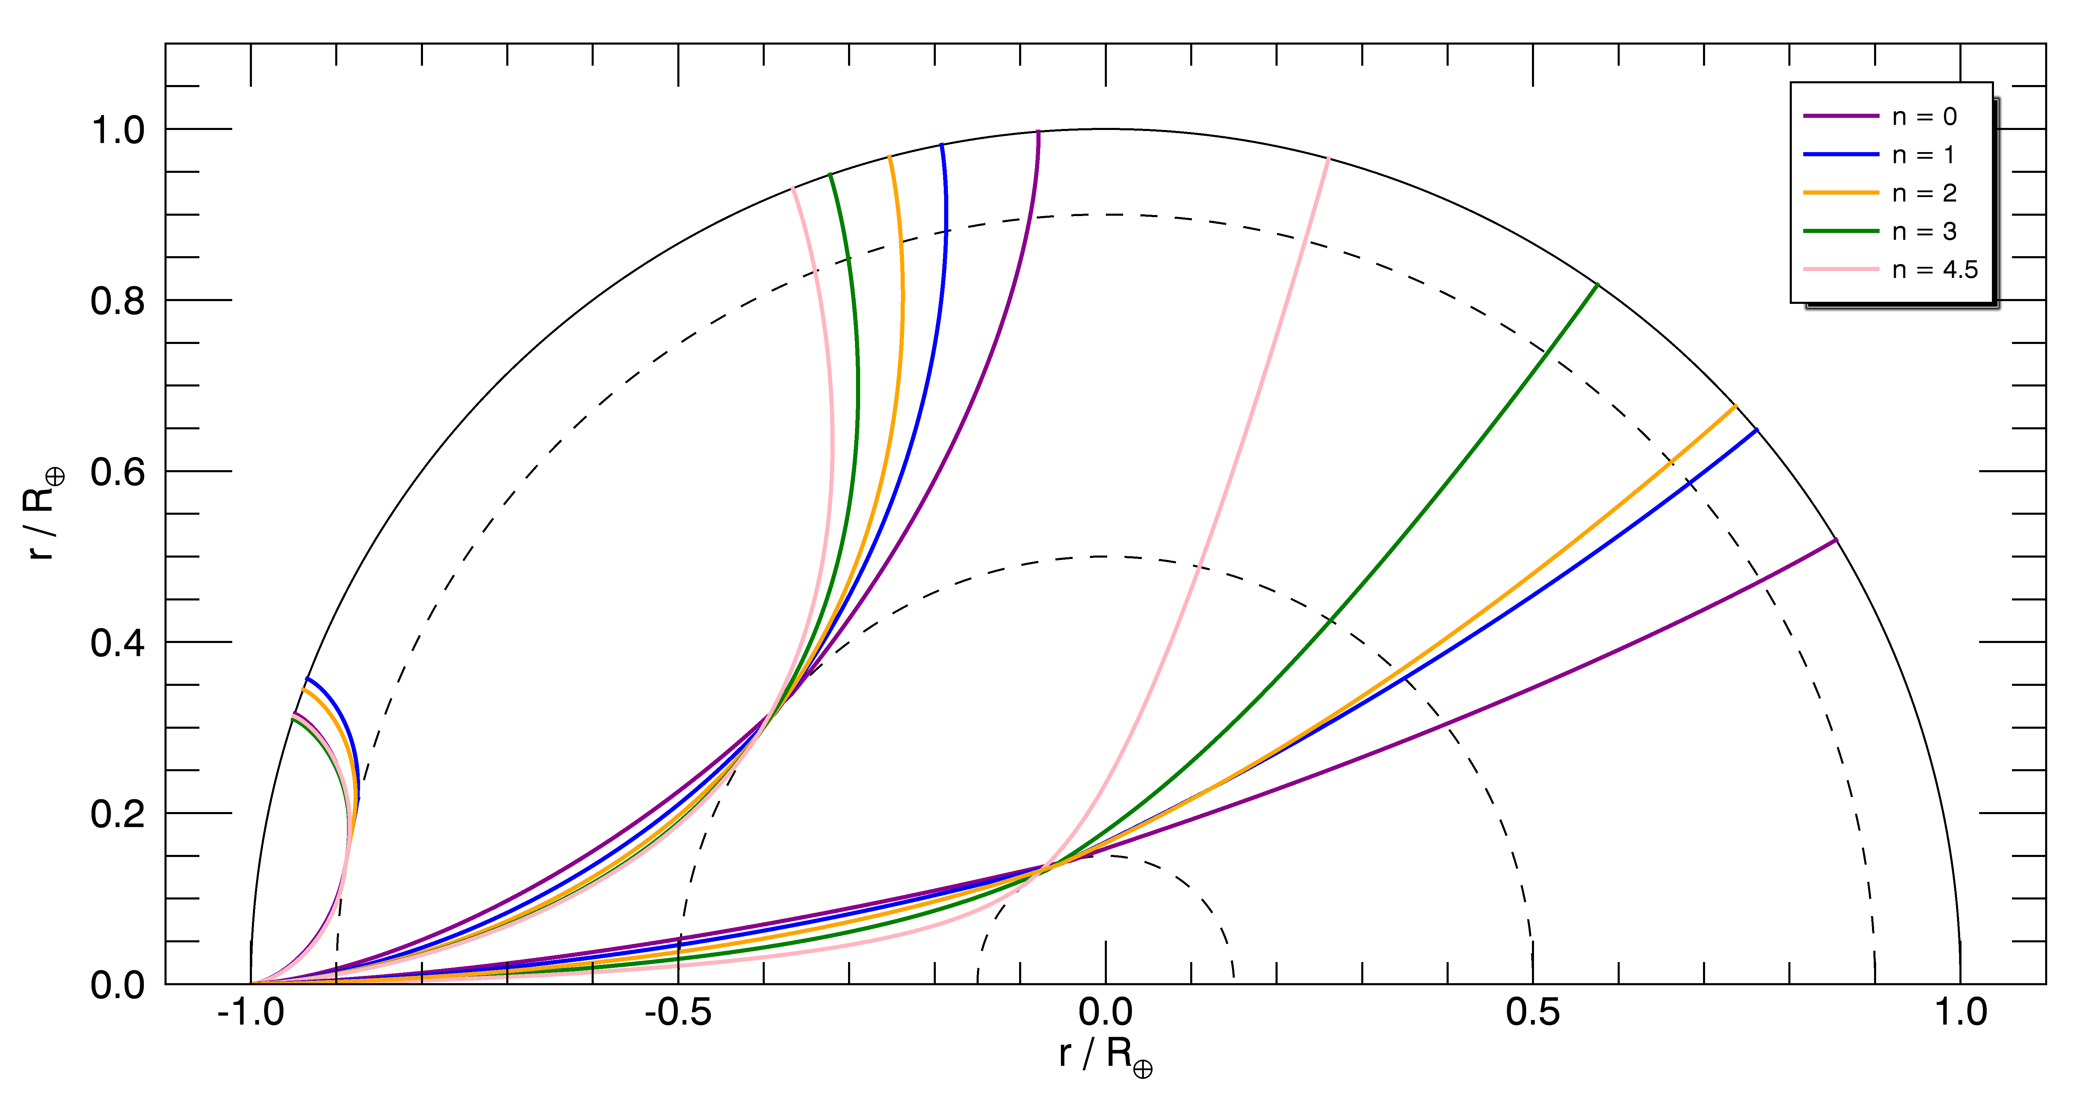
Brachistochrones
Notes:
Rotate pic. No red. No equations.
Stapp.
Pic. Red.

Slide 5
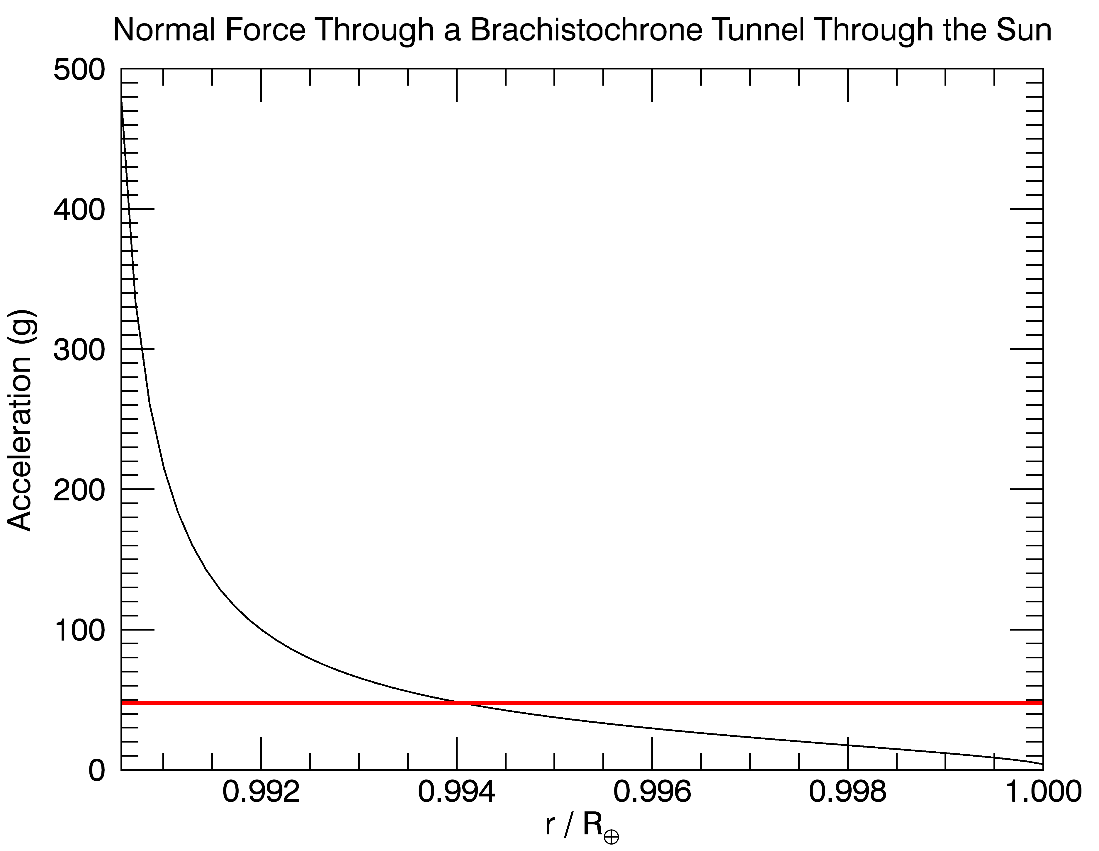
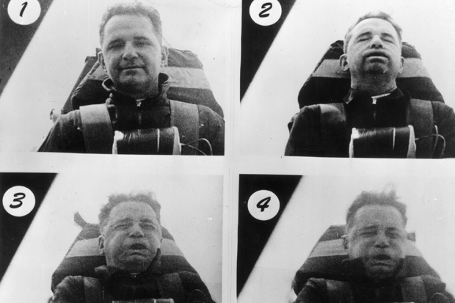

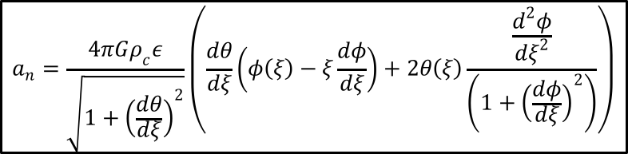
The Stapp Survival Line
$$a_{n}=\frac{4πGρ_{c}ε}{\sqrt{1+{\left(\frac{dθ}{dξ}\right)}^{2}}}\left(\frac{dθ}{dξ}\left(φ\left(ξ\right)−ξ\frac{dφ}{dξ}\right)+2θ\left(ξ\right)\frac{\frac{d^{2}φ}{dξ^{2}}}{\left(1+{\left(\frac{dφ}{dξ}\right)}^{2}\right)}\right)$$
John Stapp as he decelerates. Taken from pbs.org.
$$⨀$$
Notes:
Add equation.
Caption his face.

Slide 6
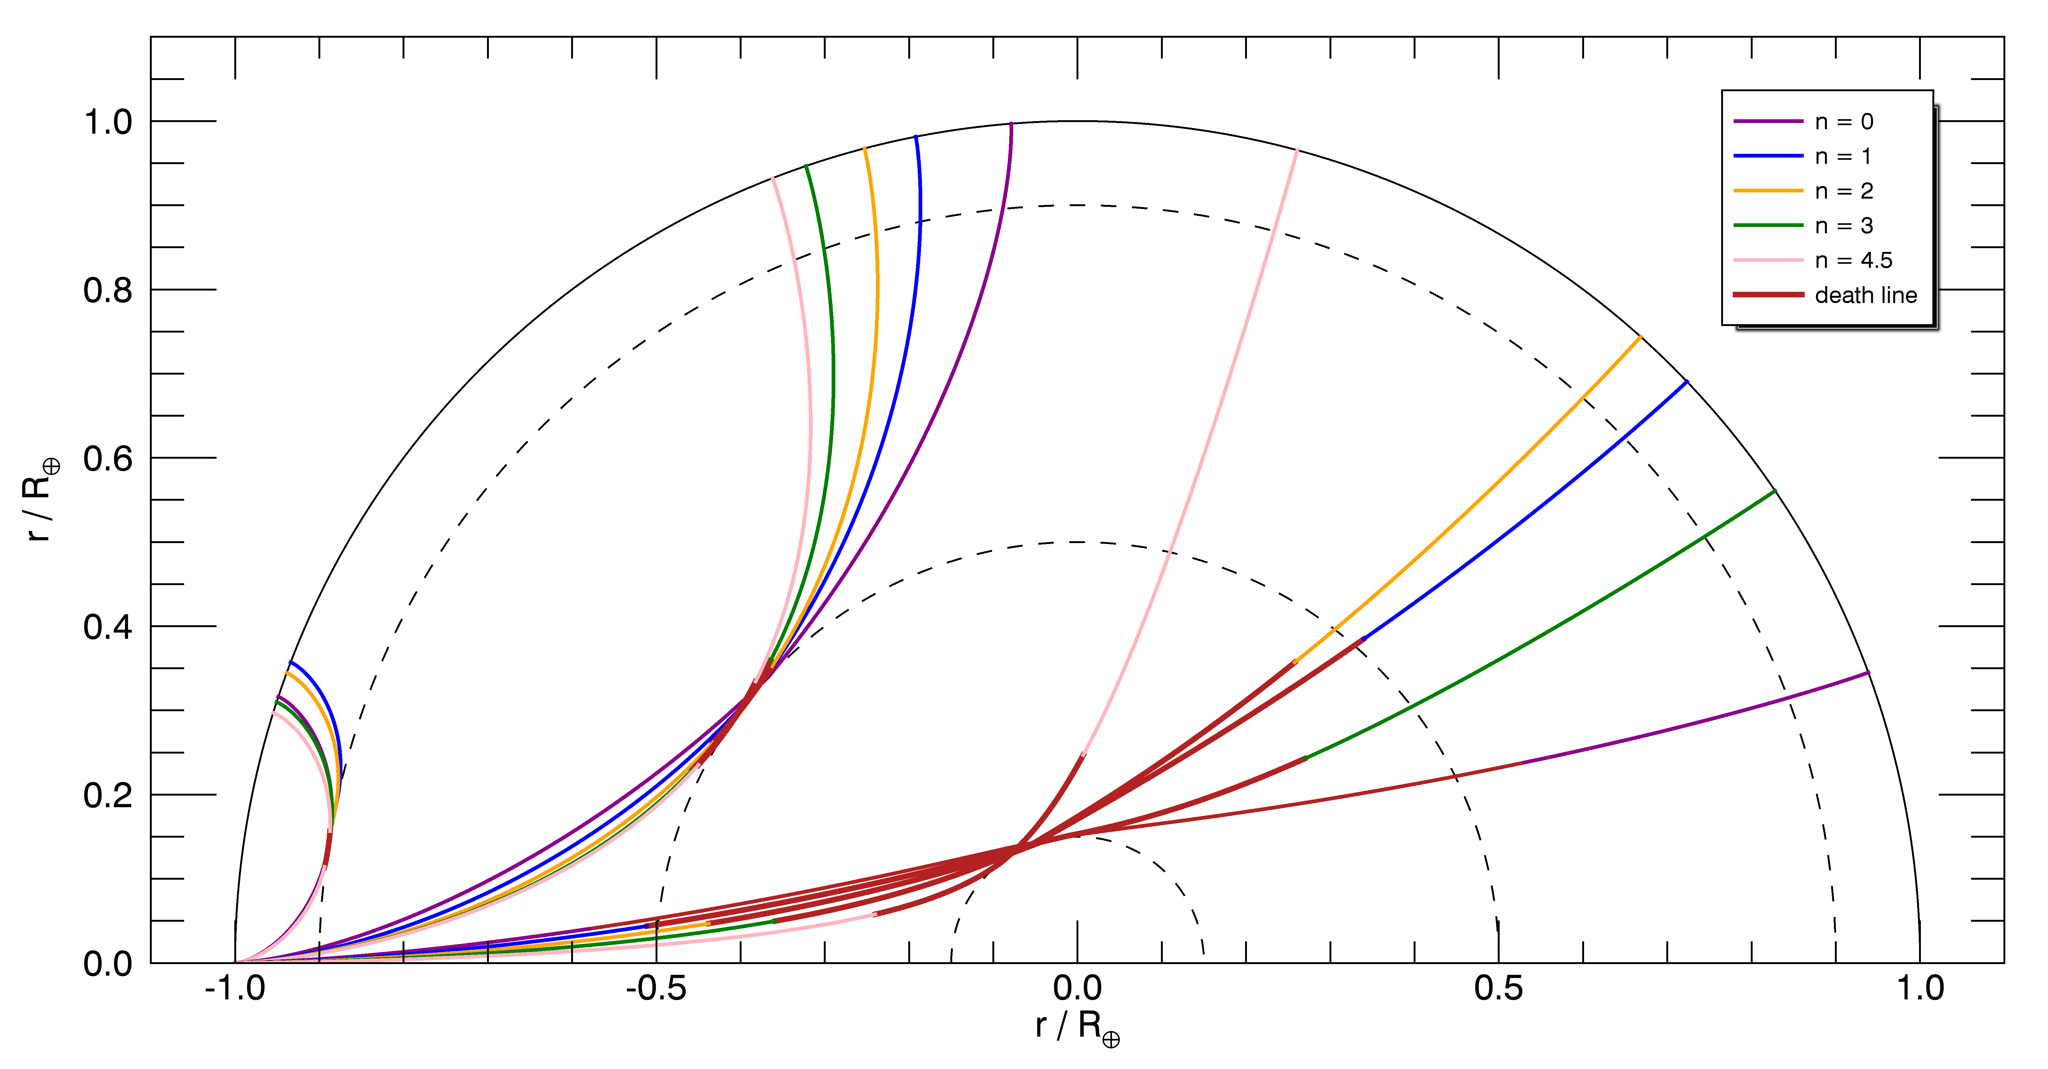
Acceleration Due to Normal Force
Notes:
Rotate pic. No red. No equations.
Stapp.
Pic. Red.

Slide 7
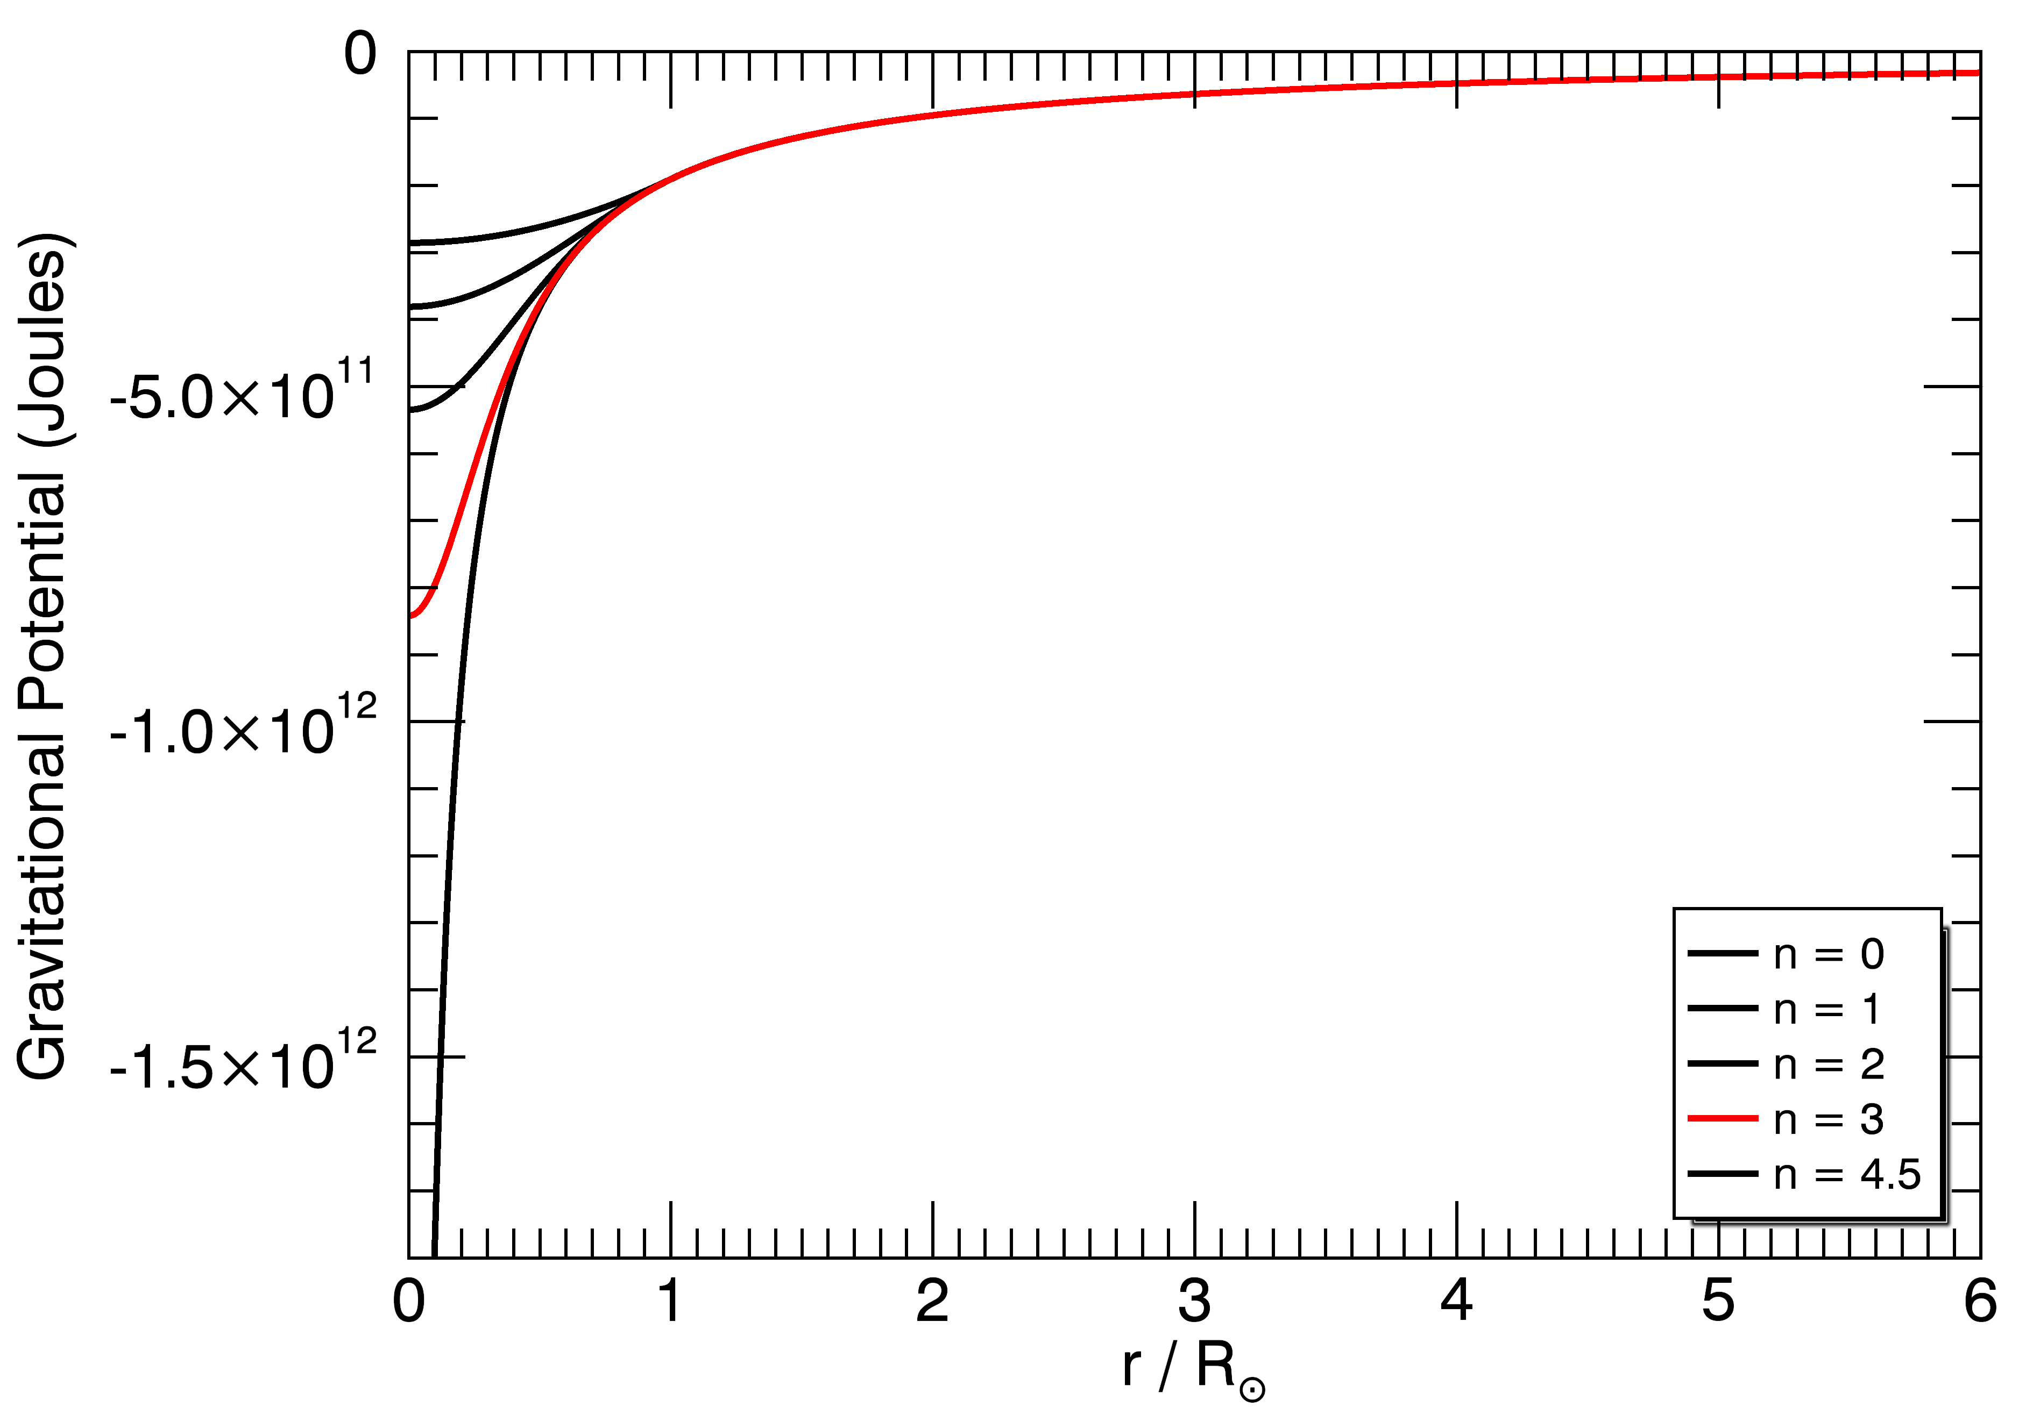
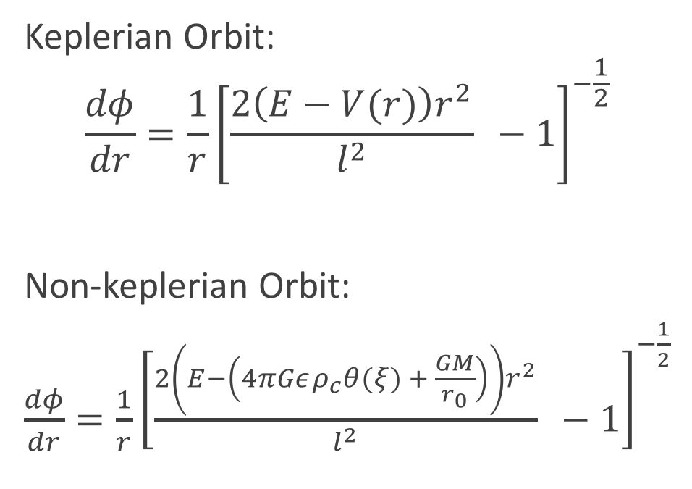
Non-Keplerian Orbit Through a Polytrope
Keplerian Orbit:
$$\frac{dφ}{dr}=\frac{1}{r}{\left[\frac{2\left(E−V(r)\right)r^{2}}{l^{2}} −1\right]}^{−\frac{1}{2} }$$
Non-keplerian Orbit:
$\frac{dφ}{dr}=\frac{1}{r}{\left[\frac{2\left(E−\left(4πGερ_{c}θ(ξ) + \frac{GM}{r_{0}}\right)\right)r^{2}}{l^{2}} −1\right]}^{−\frac{1}{2} }$
Notes:
Make graph shorter.

Slide 8
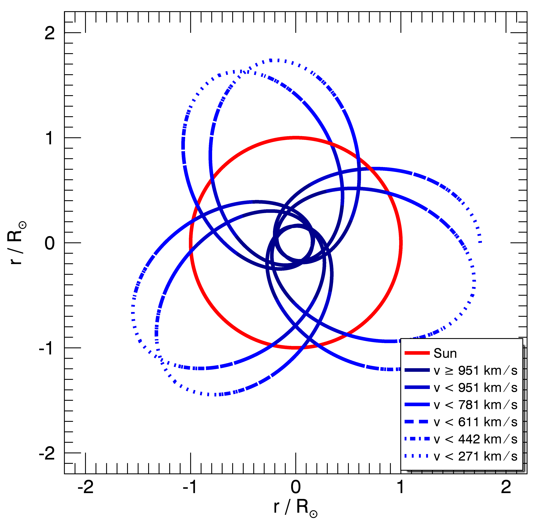
Orbital Path Through the Sun

Slide 9
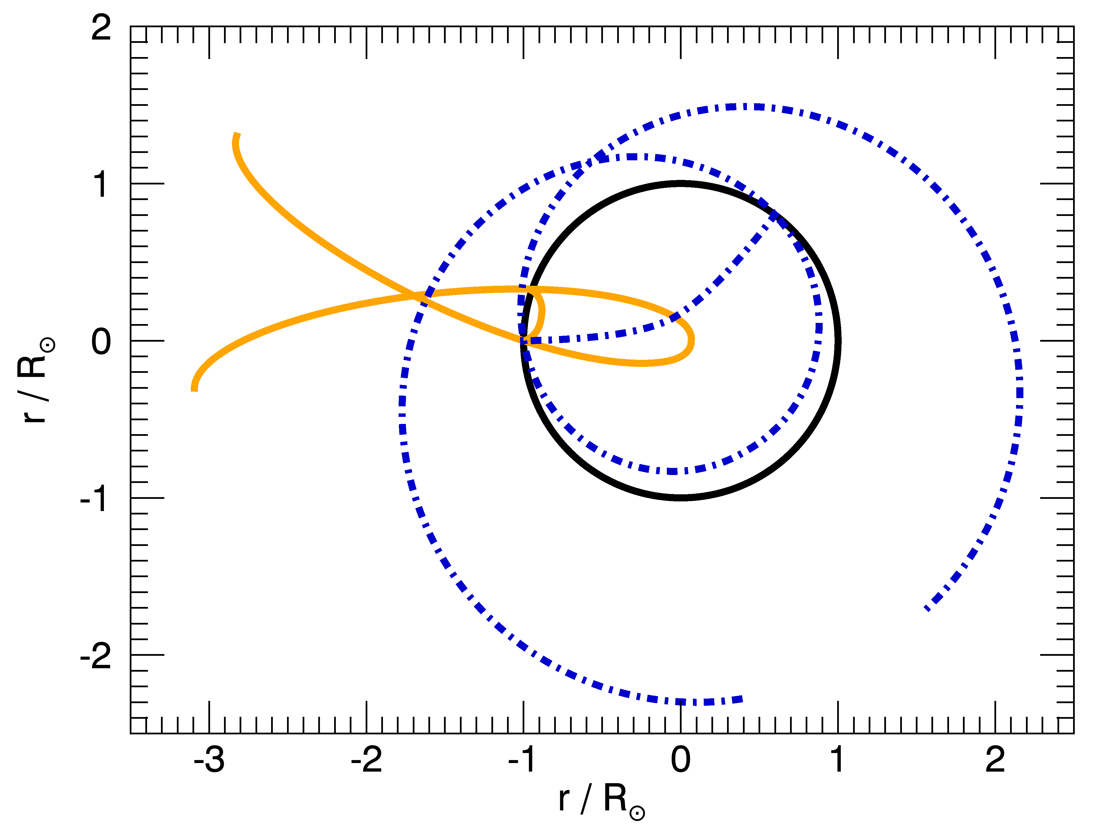
Comparing the Two Tunnels
Notes:
Get rid of dotted lines. Red line.
Show from aphelion to aphelion.
Get traversal times.

Slide 10

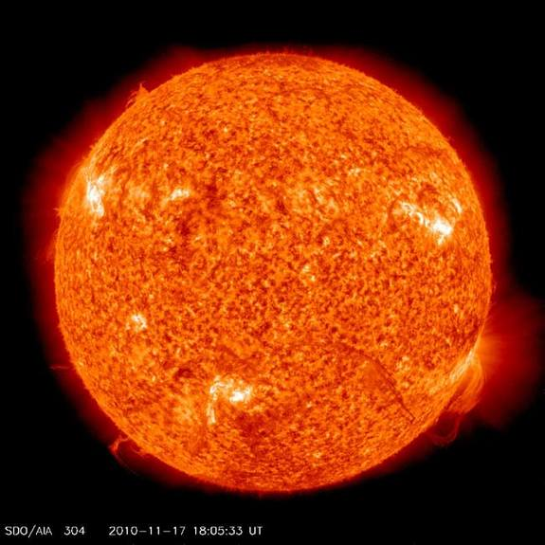

Notes:
Fix timing.
Fix orbit.

Slide 11
The Problem
If a satellite were to travel through the Sun, which path should it take?
Conclusions
Don’t dig a brachistochrone tunnel through the Sun.
Orbits that travel into and out of the Sun lead to prograde/retrograde precession.
Non-keplerian orbital paths through the Sun require very large initial velocities.
Notes:
Add thank you slide.

Slide 12
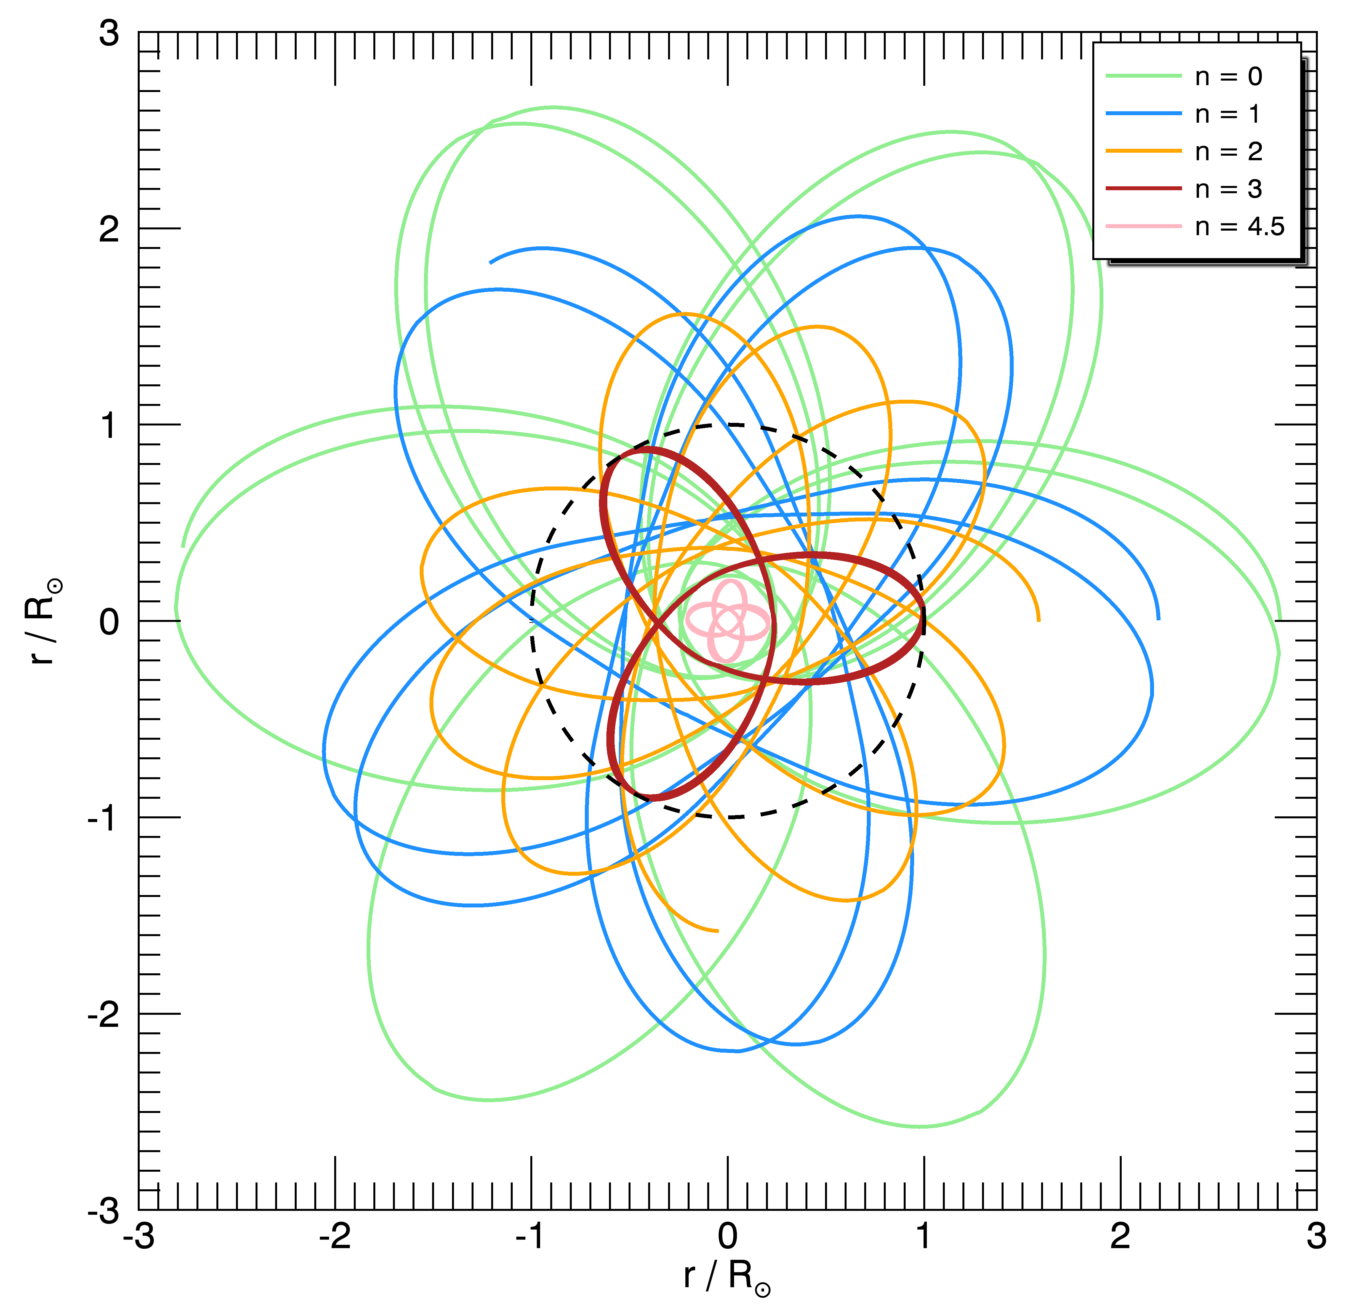
Questions?
Notes:
Add thank you slide.

Slide 13
References
Adams, Fred C., and Anthony M. Bloch, "Orbits in Extended Mass Distributions: General Results and the Spirographic Approximation," ApJ The Astrophysical Journal 629.1 (2005): 204-18. Web.
A. R. Klotz, “The gravity tunnel in a non-uniform Earth,” Am. J. Phys. 83(3), 231–237 (2015).
W. Dean Pesnell, “Flying Through Polytropes,” Am. J. Phys. 84, 192 (2016).
Notes:
Add globular clusters picture just in case

Slide 14
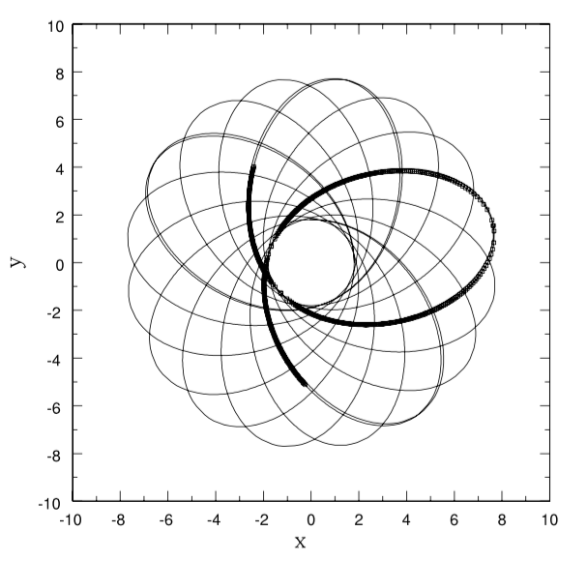
Taken from paper by Adams and Bloch, “Orbits in Extended Mass Distributions: General Results and the Spirographic Approximation.”
Notes:
Add thank you slide.

Slide 15
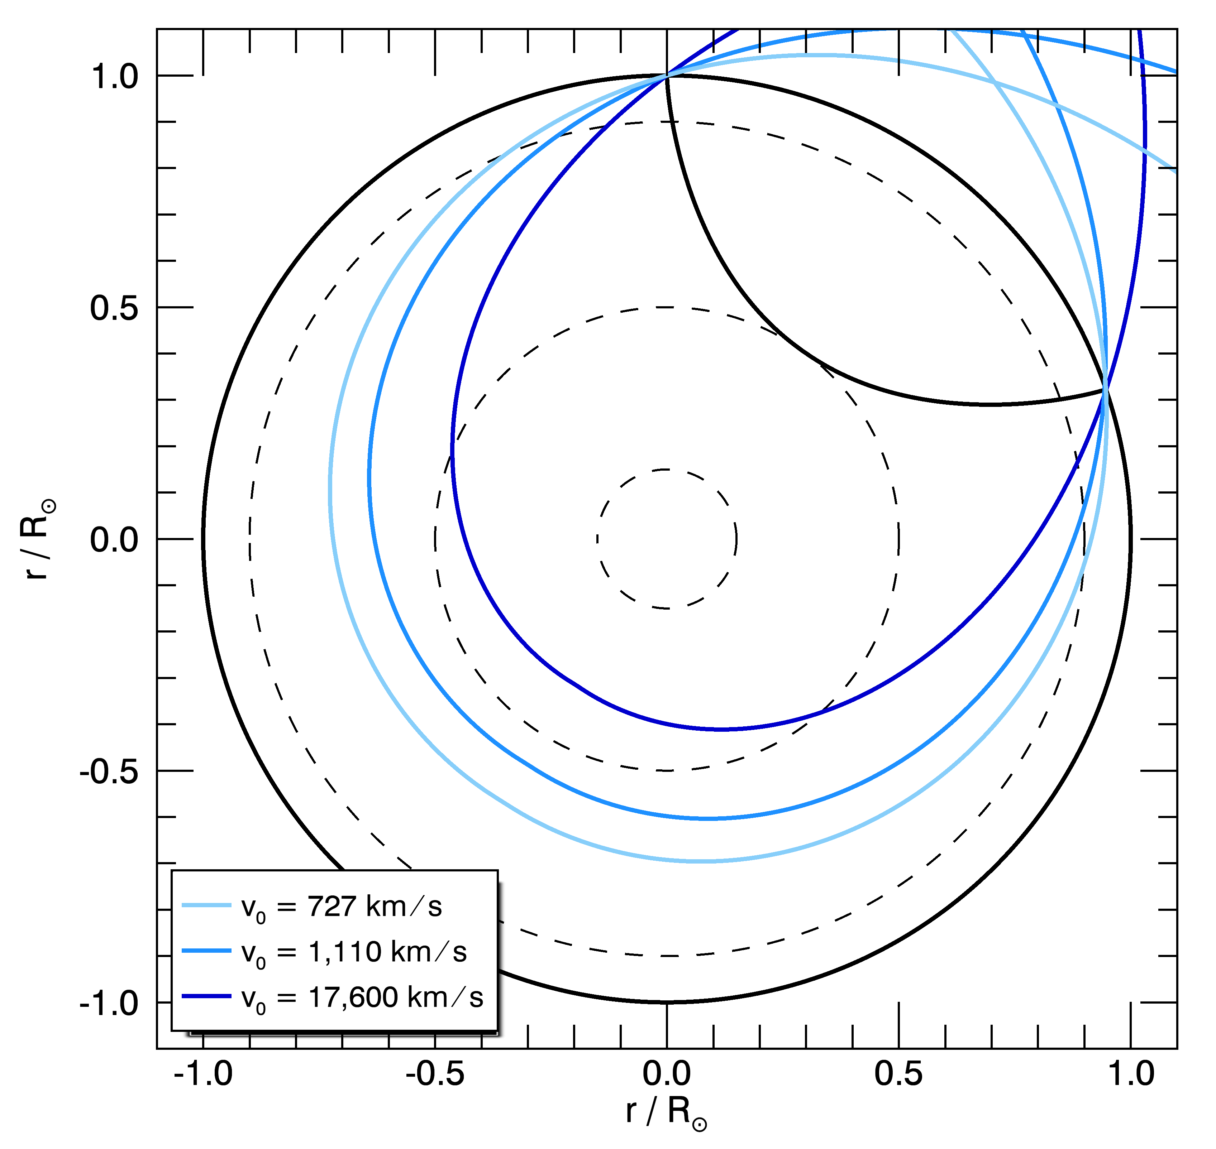
Notes:
Add thank you slide.

